Slide 1
Tweeting Emotions: Exploring Sentiment Analysis with Machine Learning

Slide 2

﻿Group Members-
Panwar Shivani (190180101038)
Priya Joshi (190180101042)
Shivani Sharma (190180101051)
Yogita (190180101063)
﻿
Under the guidance of-
Ms. Swati Verma
( Asst.Professor)
﻿

Slide 3
Problem Statement

Slide 4

Introduction
Sentiment analysis on social media platforms has become increasingly important in recent years due to the vast amounts of data available. Twitter, in particular, provides a wealth of data that can be analyzed to gain insights into public opinion and sentiment towards various topics.
In this presentation, we will explore the use of different machine learning algorithms for sentiment analysis on Twitter data. We will discuss the advantages and limitations of each algorithm and provide examples of how they can be used to extract valuable insights from Twitter data.

Slide 6
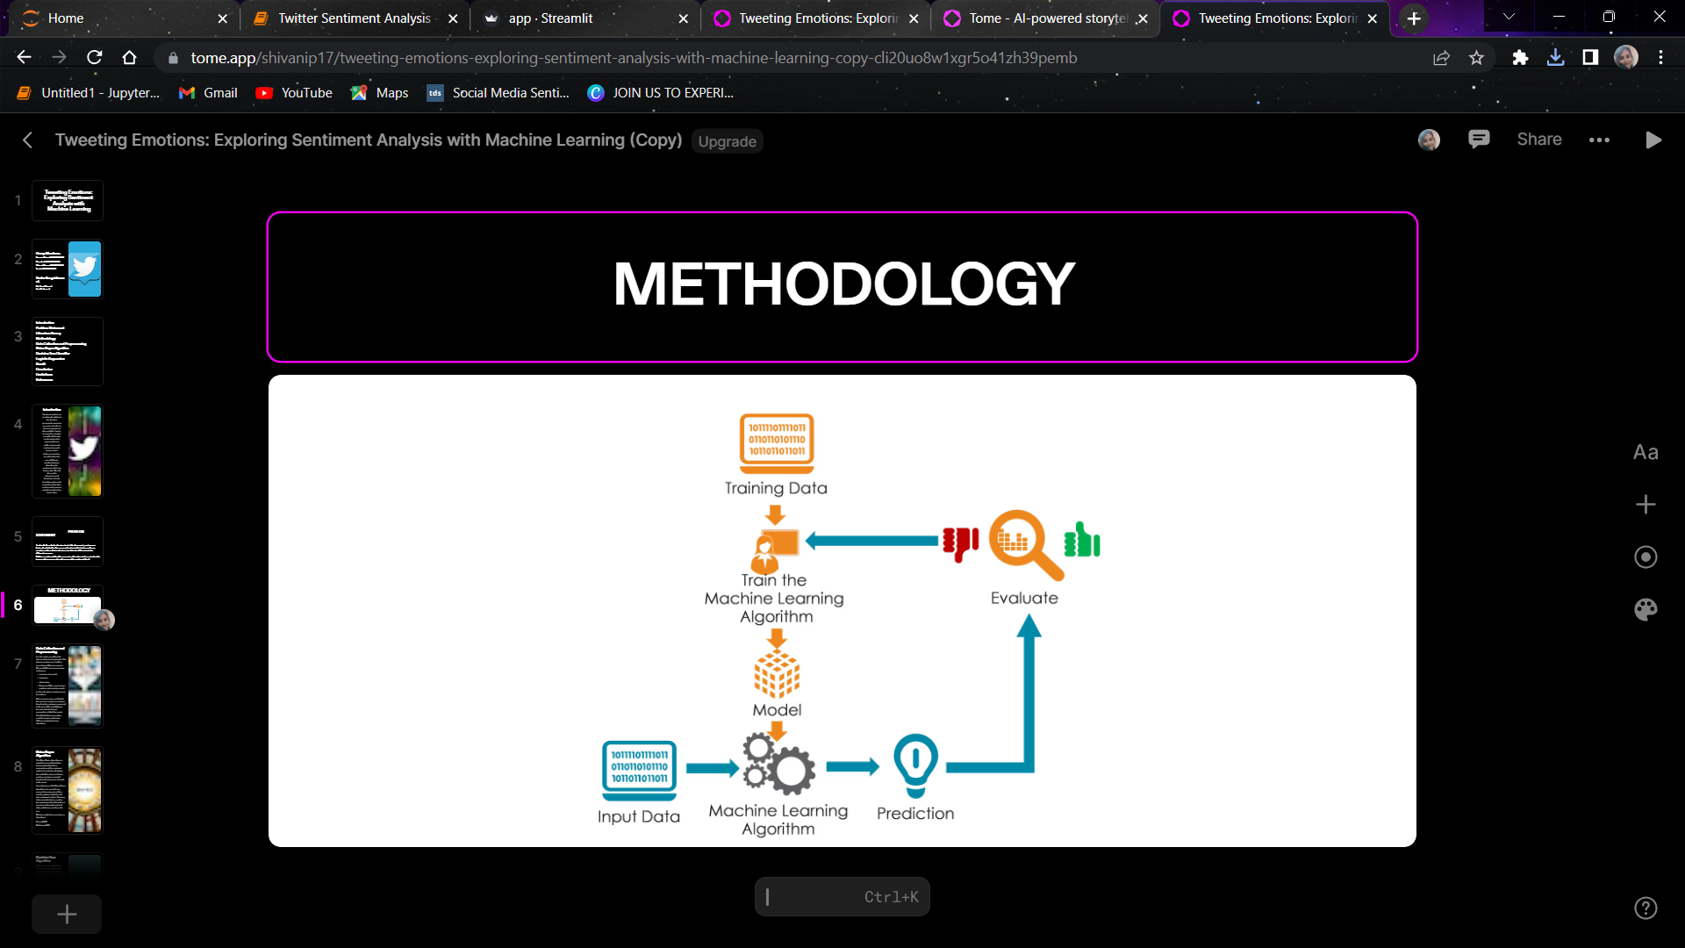
METHODOLOGY

Slide 7

Data Collection and Preprocessing
For this study, we collected a dataset of tweets from kaggle. The dataset contains over 1 million tweets from different countries . We used different preprocessing techniques
removing stop words
tokenization
Removing URLs, punctuations, numbers and repetitive words
to clean the dataset and prepare it for analysis.
After preprocessing, we labeled the tweets as positive or negative based on the sentiment expressed in the tweet. We used different lexicons and rule-based approaches to label the tweets. The labeled dataset was then used for training and testing different machine learning algorithms.

Slide 8

Naive Bayes Algorithm
Naive Bayes algorithm is a simple but powerful machine learning algorithm that is commonly used for sentiment analysis. It works by calculating the probability of a tweet being positive, negative, or neutral based on the frequency of words in the tweet.
One advantage of the Naive Bayes algorithm is its speed. It can process large amounts of data quickly, making it ideal for real-time sentiment analysis. However, it has some limitations, such as the assumption that all words in a tweet are independent of each other, which may not always be true.
We have applied two naive bayes algorithms:
Bernoulli NB
Multinomial NB
﻿

Slide 9
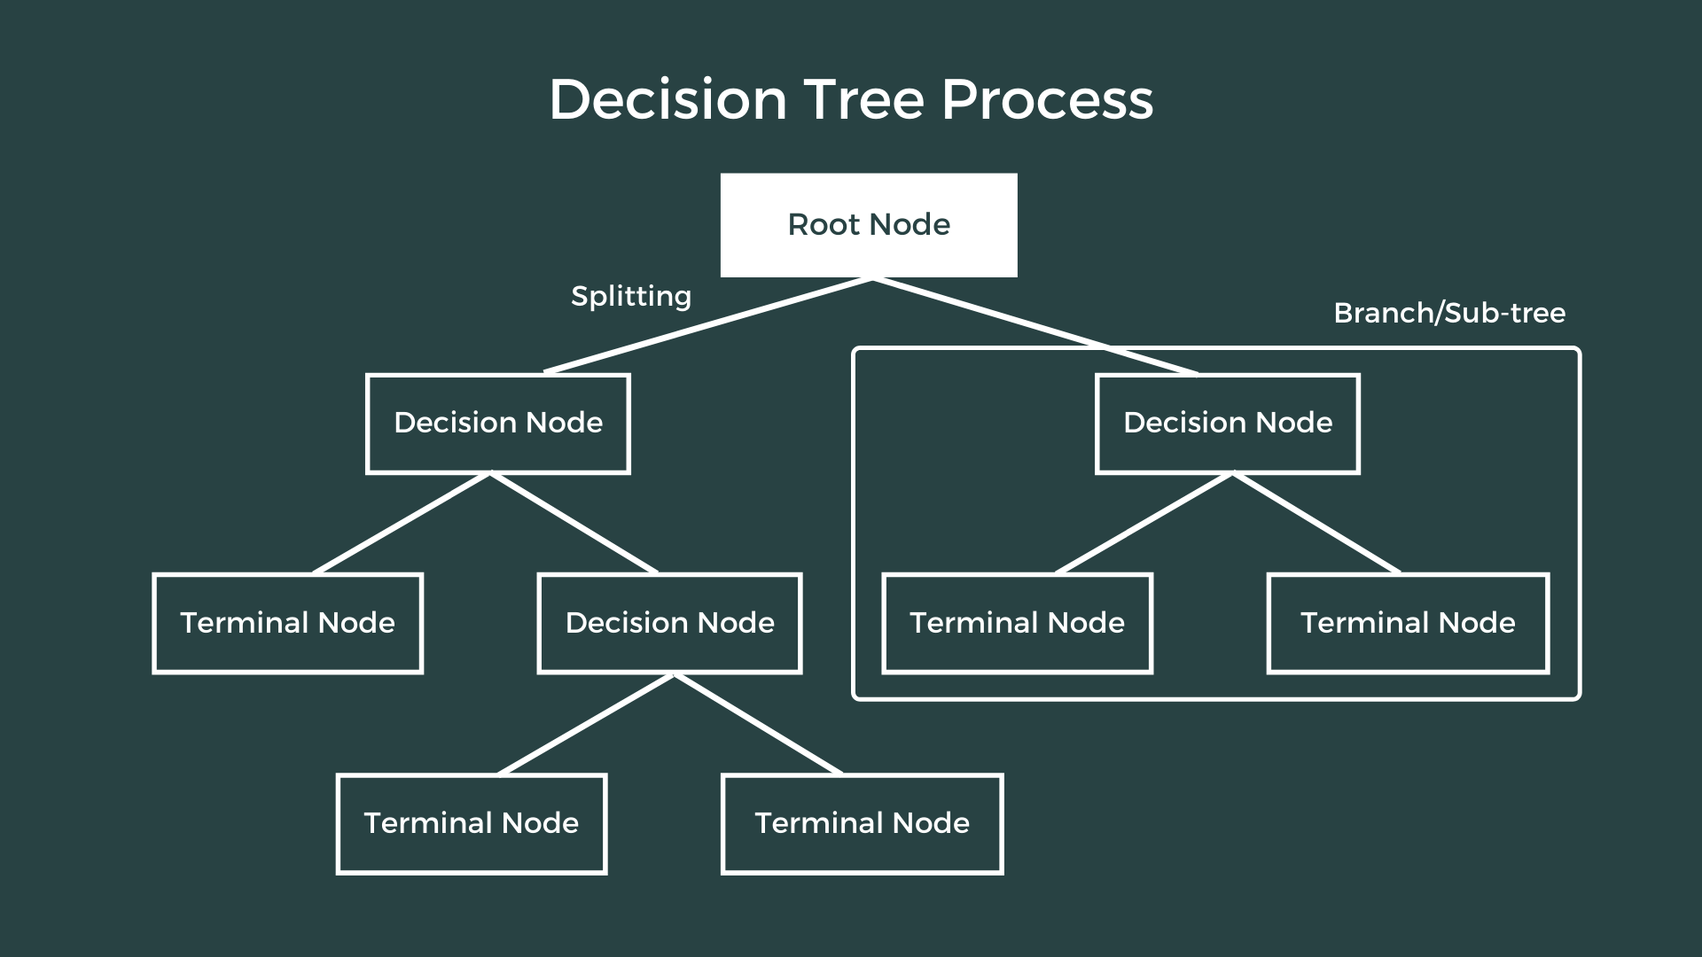
Decision Tree Algorithm
A decision tree is a flowchart-like tree structure where each internal node denotes the feature, branches denote the rules and the leaf nodes denote the result of the algorithm. It is a versatile supervised machine learning algorithm, which is used for both classification and regression problems. In the case of sentiment analysis, SVM can be used to classify tweets as positive or negative.
It is one of the very powerful algorithms. And it is also used in Random Forest to train on different subsets of training data, which makes random forest one of the most powerful algorithms in machine learning. However, they are computationally expensive and it is a high variance algorithm.

Slide 10
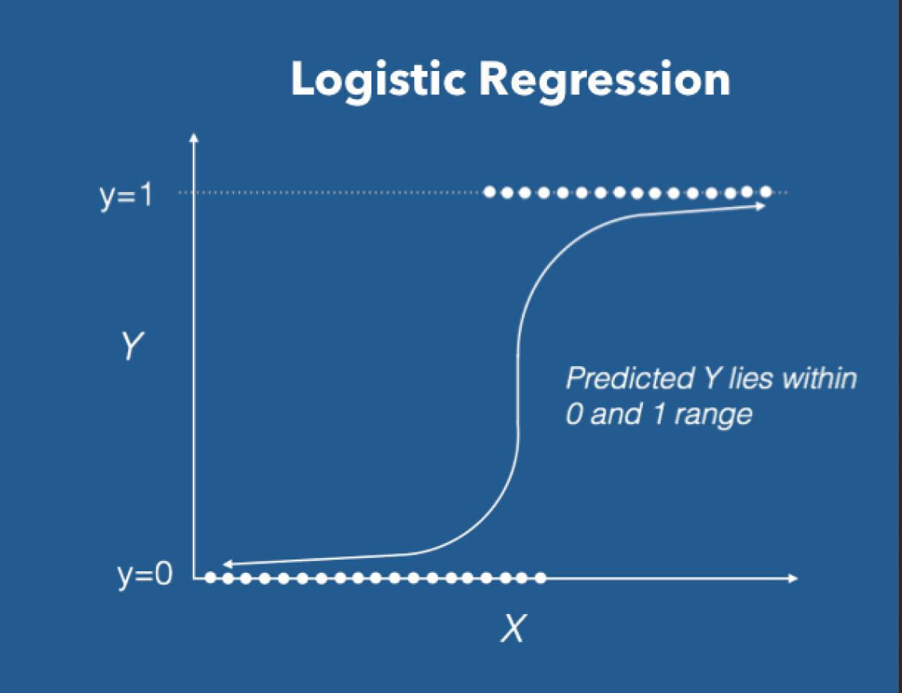
Logistic Regression
Logistic Regression is a machine learning algorithm commonly used for binary classification tasks such as sentiment analysis. It works by modeling the probability of a tweet being positive or negative based on the values of its features.
One advantage of Logistic Regression is its simplicity and interpretability. It can also handle non-linear relationships between features using techniques such as polynomial regression. However, it may not perform as well as other algorithms when dealing with complex data.

Slide 11

RESULT﻿
Accuracy of algorithms we used in our model:
Bernoulli Naive Bayes: 73%
Multinomial Naive Bayes: 75%
Decision Tree Classifier: 74.7%
Logistic Regression: 75.2%
﻿

Slide 12

Conclusion
In conclusion, sentiment analysis on Twitter data using machine learning algorithms can provide valuable insights into public opinion and sentiment towards various topics. Each algorithm has its advantages and limitations, and the choice of algorithm depends on the specific task and data at hand.
Logistic Regression showed maximum accuracy of 82% among all the algorithms we applied.
By understanding the strengths and weaknesses of each algorithm, we can make informed decisions when analyzing Twitter data and extract meaningful insights that can inform decision-making in various fields such as marketing, politics, and social sciences.

Slide 13
Limitations
Neutral tweets: The current model doesn't consider neutral sentiments, even though many tweets do not exhibit a clear-cut positive or negative emotion, especially the ones stating a fact or news.
Bi-grams in combination with unigrams to handle negations like ‘not good’.
Semantics may be employed when the sentiment of a tweet depends on the perspective of the reader. For example: “India lost to Australia in the semi-finals.” indicates negative sentiment for India, but positive sentiment for Australia.

Slide 14

References
1. Pak, A., & Paroubek, P. (2010). Twitter as a corpus for sentiment analysis and opinion mining. In LREC (Vol. 10, pp. 1320-1326). https://lexitron.nectec.or.th/public/LREC-2010_Malta/pdf/385_Paper.pdf﻿
2. Agarwal, A., Xie, B., Vovsha, I., Rambow, O., & Passonneau, R. (2011). Sentiment analysis of Twitter data. Proceedings of the workshop on languages in social media (pp. 30-38). https://aclanthology.org/W11-0705.pdf﻿
3. François Bar and Shrikanth Narayanan. A system for real-time twitter sentiment analysis of 2012 us presidential election cycle. https://aclanthology.org/P12-3020.pdf﻿

